Slide 1
NDSCS UPDATE
2023-2024

Slide 2
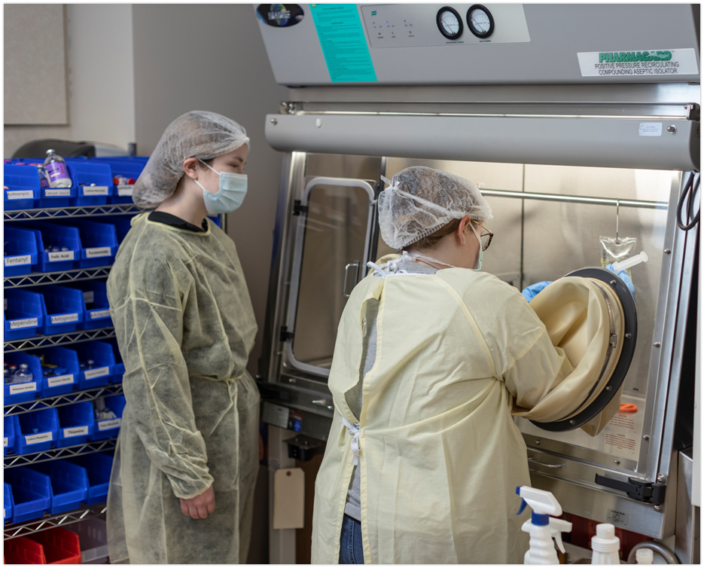
Pharmacy Technician program:
Notes:
The Pharmacy Technician program is designed to prepare students for careers performing and managing the technical distributive functions in pharmacies and pharmacy-related industries.

Slide 3
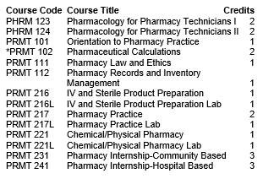
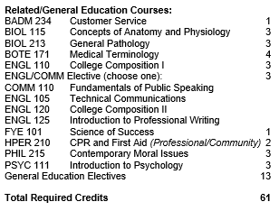
AAS degree
Certificate
Notes:
We made some curriculum edits this year and reduced the program by 7 credits. This reduction removed some redundancy in the program and streamlines the students into the workforce faster
NDSCS offers two program degree options — a one-year (32 academic credits) Certificate and a two-year (61 credits) Associate in Applied Science degree. Both of these include six weeks of internship in community and institutional practice settings, completed in the last half of the spring semester now .

Slide 4
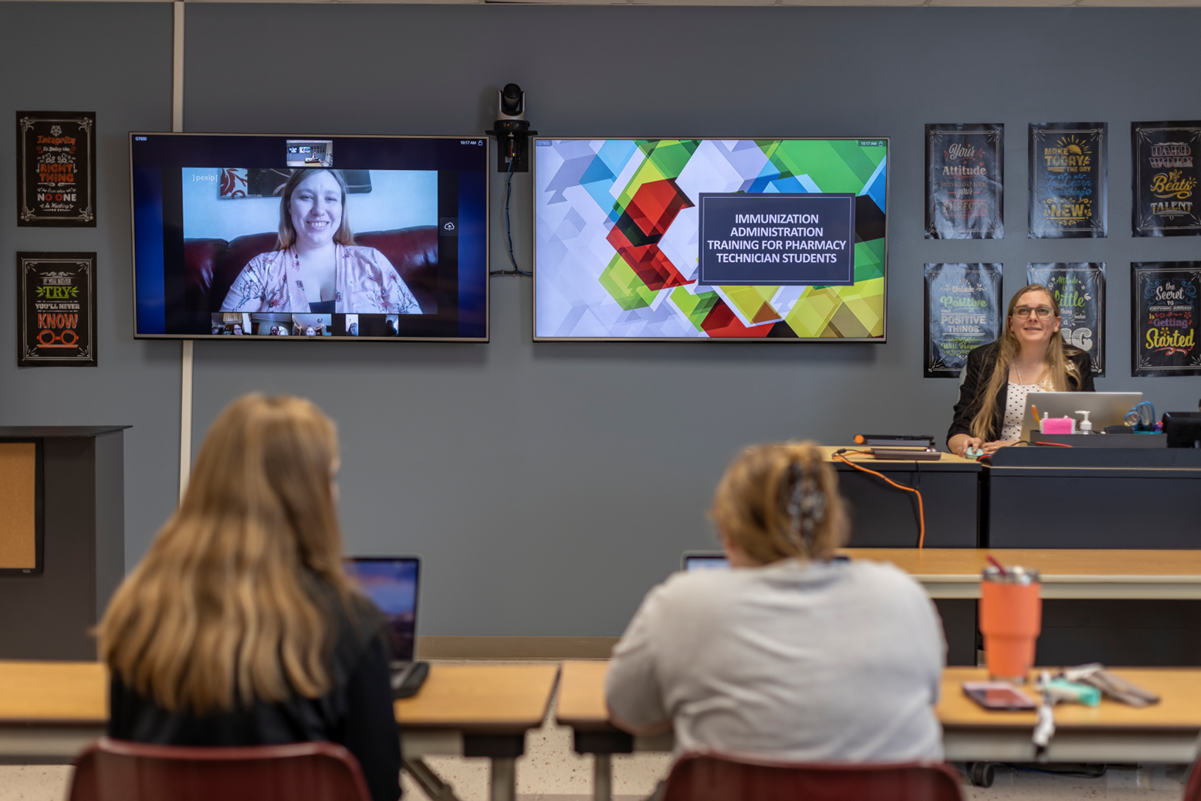
Hyflex delivery
Notes:
Most students choose to attend the Pharmacy Technician program in person this year, we did switch from hybrid to hyflex delivery this fall. Previously students were required to attend class in person or via live stream. The hyflex option allows students to also watch recordings to our lectures to be a more traditional online student.

Slide 5
Course Delivery Utilization
Notes:
We had two students that choose this delivery modality. Six that attended in person and one that live streamed into the courses this year.

Slide 6
NDSCS Pharmacy Technician Graduates
Notes:
The number NDSCS Pharmacy Technician Graduates
2024 #9
2023 #4
2022 #7
2021 #10
2020 #5
2019 #4
2018 #8
Perspective gradates for the class 2025 is currently 10 students

Slide 7
Notes:
NDSCS Pharmacy Technician graduates have passed the Pharmacy Technician Certification Exam at 100% since 2017 the national average is around 70%

Slide 8
Injection Administration Training
Notes:
Since 2021 the curriculum of the NDSCS Pharmacy Technician Program has included training to administer injections as defined in CHAPTER 61-04-11 ADMINISTRATION OF MEDICATIONS AND IMMUNIZATIONS

Slide 9
Changes made to improve the student learning experience:
Pharmacist Assisted Technician Self Instructional Modules (PATSIM) for college credit now
Dual credit high school PATSIM offering
Notes:
The Pharmacy Technician program had a work force affairs non-credit TrainND offering that’s called Pharmacist Assisted Technician Self Instructional Modules (PATSIM) On July 1st, 2023, a new version of the PATSIM program was release and is now offered for college credit and is considered an entry level program for our ASHP/ACPE accreditation standards. This program now utilizes an exam video proctoring service for added flexibility. We have 20 students currently enrolled in this apprenticeship program
A dual credit PATSIM program began fall of 2023 at the Central Cass high school, this cohort is sponsored by Essentia Health via a workforce grant they received. We have 9 students enrolled that will be completing all 11 modules by mid May.
With all options we now have at total 50 students currently enrolled in the NDSCS pharmacy technician program.

Slide 10
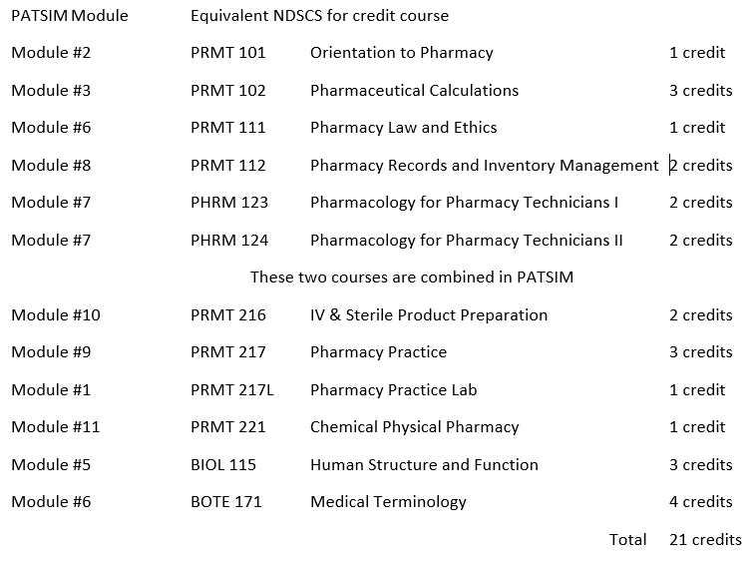

Slide 11
Notes:
The Pharmacy Technician Accreditation Commission voted on October 24, 2023:
To approve for reaccreditation the pharmacy technician education and training program at North Dakota State College of Science,
They granted accreditation for six years until 2029

Slide 12
ND Career Builders
How Can the ND Scholarship & Loan Repayment Program Work for You?
Be part of the solution to keep talent in ND.
Donate, participate, or learn more
NDUS.edu/career-builders
701-328-2906
ndfinaid@ndus.edu.
Notes:
The ND Career Builders program began in 2021 it provides matching funds to help North Dakota businesses recruit employees and keep talent in North Dakota. They are seeking businesses to participate and invest in this unique partnership!
It is a tool for businesses to recruit and retain talent in high-need occupations in ND, this innovative partnership provides $1 of state funds for each $1 of private-sector matching funds, up to a total of $17,000 per recipient! Individuals can receive a scholarship on the front end, loan repayment on the back-end, or both, for their commitment to the state to fill one of the high-demand occupations. It is a win-win for businesses, students, employees, and the state!
Be part of the solution to keep talent in ND.
You can donate, participate or learn more about the ND Career Builders Scholarship & Loan Repayment program at NDUS.edu/career-builders or contact NDUS directly by phone at 701-328-2906 or email at ndfinaid@ndus.edu.

Slide 13
Melissa Krava Pharmacy Technician Program Director melissa.krava@ndscs.edu 701-671-2114

